Slide 1
Timeline
To accompany
Night by Elie Wiesel

Slide 2
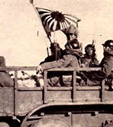
1931
Japan invaded Manchuria, beginning hostilities in the Far East.

Slide 3
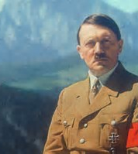
1933
Adolf Hitler is appointed Chancellor of Germany.

Slide 4
1935
Nuremberg Race Laws
Deprived Jews of German citizenship

Slide 5
1936
SS renamed its units deployed at concentration camps the “Death Head Units”.

Slide 6
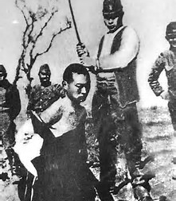
1937
Japan invades China

Slide 7
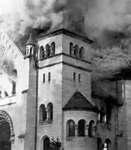
1938
Kristallnacht
Night of Crystal
Night of Broken Glass

Slide 8
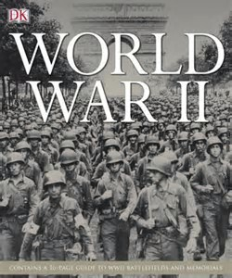
1939
Hitler violates Munich Agreement of 1938. In September , Germany invaded Poland.

Slide 9
1940
Germany conquered Denmark, Norway, France, Belgium, Luxembourg, and the Netherlands.
Winston Churchill becomes British Prime Minister.
Auschwitz concentration camp is established.
Italy declares war on Britain and France.

Slide 10
Romania is compelled to give up northern Transylvania, including Sighet, to Hungary.
In autumn, Hungary, Romania, and Slovakia join the German-Italian alliance called the axis.

Slide 11
1941
Nazi Security Police Chief Reinhard Heydrich is given authorization to plan and cooridunate a “total” and “final” solution of the “Jewish Question.”
Construction of Auschiwitz-Birkenau camp (Auschiwitz II) begins
U.S. enters war after Japanese attack Pearl Harbour

Slide 12
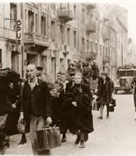
1943
Jews in the Warsaw ghetto rise up against their oppressors.
Germans and their axis partners killed more than 4,000,000 European Jews.

Slide 13
1944
Germany occupies Hungary.
440,000 Hungarian Jews are deported, most to Auschwitz.
June 6, D-Day, Anglo-American forces establish the first Allied beachhead in western Europe on the Normandy coast of German occupied France.
November, 1944, Reichsfuhrer SS Heinrich Himmler orders a falt to the “Final Solution” and orders the destruction of the gas chambers at Auschwitz-Birkenau.

Slide 14
1945
Soviet troops liberate Auschwitz on January 27.
U.S. troops liberate Buchenwald on April 11.
Germany surrenders on May 7.
World War II in Europe ends on May 8.
September 2, the Pacific War ends with the surrender of Japan after the U.S. drops atomic bombs on Hiroshima and Nagasaki in August.

Slide 15
United Nations is founded.
International Military Tribunal in August
Allies (France, Great Britain, the Soviet Union) indict 22 top-ranked Nazi leaders and six German and Nazi Party Organizations for crimes against the peace, war crimes, and crimes against humanity.
SS units evacuate Auschwitz in January

Slide 16
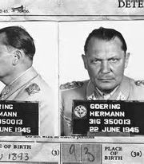
1946
Eighteen of 21 defendants are convicted by the International Military Tribunal at the Nuremburg Trial
Twelve are sentenced to death.

Slide 17
1945-1949
177 Nazi offenders are tried under the jurisdiction of the International Tribunal in 12 consecutive Nuremerg trials of second rank Nazi leaders.
Thousands more Nazi perpetrators and their collaborators are tried in the four zones of occupied Germany and in the countries that Germany and its Axis partners occupied.

Slide 18
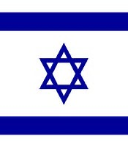
1948
The State of Israel is created .
The last British forces withdraw from Palestine and the State is established in accordance with the United Nations Partitions Plan that proposed the partition of Palestine into two states, an Arab state and a Jewish state.

Slide 19
1948
U.S. Congress passes the Displaced Persons Act, authorizing 200,000 displaced persons to enter the United States.
December 9, the United Nation
Approves the Convention on the Prevention and Punishment of the Crime of Genocide

